Slide 1
HOW TO PLACE DEVICE ORDERS
HANDS FREE SECURITY
www.handsfreellc.com

Slide 2
AGENDA
STEP 1
STEP 2
STEP 3
What needs to be included in the e-mail
How to locate information to request a device order
Sending the e-mail request
STEP 4
STEP 5
STEP 6
After completed, signed, and dated confirmation form is completed
How to complete device order confirmation form
How to receive your order

Slide 3
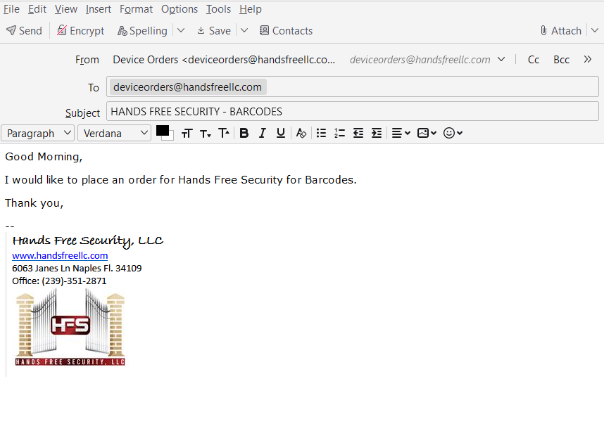
Sending The E-mail Request
STEP 1
All and any device orders must be sent to :
deviceorders@handsfreellc.com
Property name must be in the subject line along with what device is being requested
Property name must be made clear in the subject line
All device orders must be placed when property is halfway through their current order

Slide 4
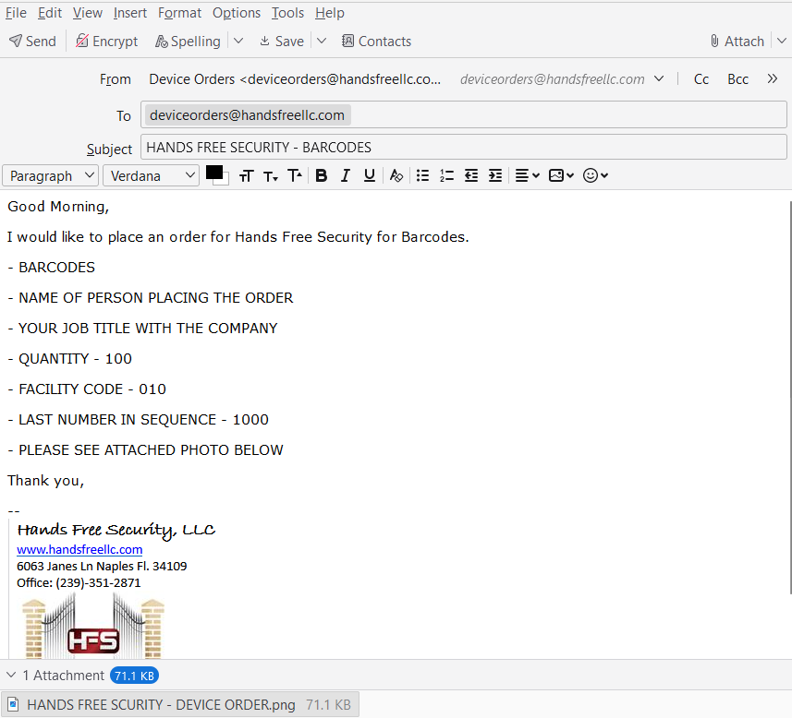
What Information Needs To Be Included In The E-mail
STEP 2
Each time a device order is placed the following information needs to be provided:
Who is placing the order and their job title with the company
What device is being requested – example: barcodes
Quantity
Last number in sequence
Facility code
An attachment of a picture of device that is being requested
Property will be responsible to manage and provide all information that is required to request a device order

Slide 5
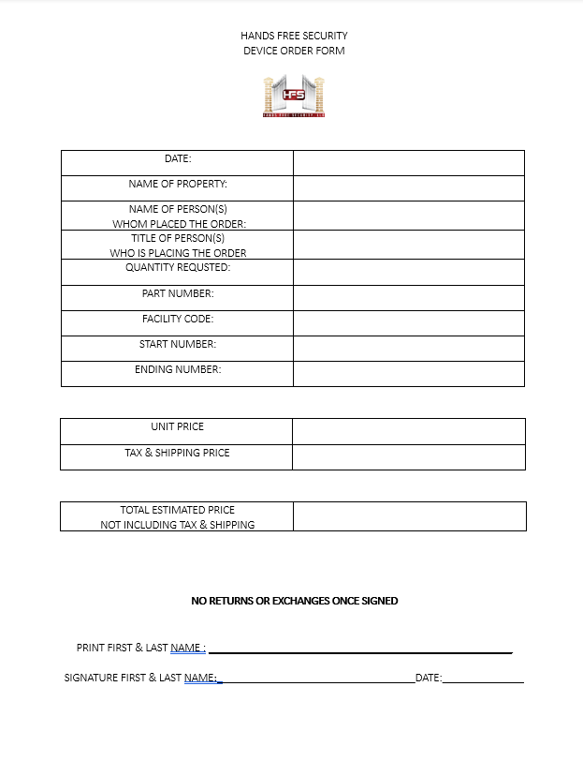
How to Locate Information Needed to Request a Device Order
STEP 3
All information will be provided on the initial confirmation form that hands free will send over to confirm order.
It is the properties responsibility to keep track of prior order confirmation sheets to provide all information needed for the new order they would like to place.
Hands free is not to be relied on to provide the correct updated information to place a new device order.

Slide 6
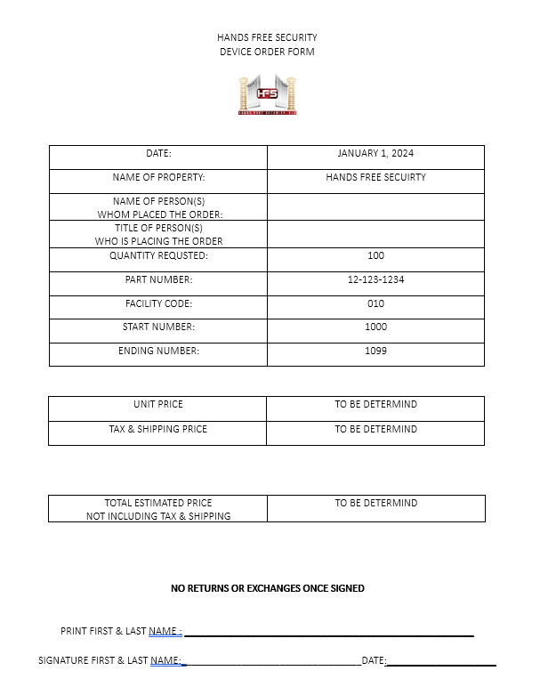
How to Complete Device Order Confirmation Form
STEP 4
Hands free will provide most information on confirmation form based off of the information the property provided in step 2
Any blank box on the form that is sent over not completed by hands free needs to be completed by the property placing the order
Confirmation form must be completed, signed, and dated before hands free can officailly submit the order request to the vendor
All information in photos are for example only. Do not use any information as a reference.

Slide 7
After Completed, Signed, and Dated Confirmation Form is Completed
STEP 5
If hands free is provided with an estimated shipping date/time and/or tracking number hands free will then provide that to you
Hands free is not responsible for any shipping delays, stocking issues, or how long the order takes to process and/or arrive once it is submitted to the vendor
Once hands free receives completed, signed, and dated confirmation form order will then be submitted to vendor

Slide 8
How to Receive Your Order
STEP 6
There are two options to choose from on how you can receive your order :
All orders must be delivered to the hands free office from vendor
OPTION 1 - Mail: provide us with the best address, suite number, contact name, phone number, and e-mail.
There will be a required signature upon delivery in order for package to be.
OPTION 1 - Someone can schedule a time to come pick them up from the hands free office.
Once hands free receives your order you will be contacted via e-mail

Slide 9
THANK YOU!
www.handsfreellc.com

